Slide 1
lifi technology -Data transfer using light
GROUP - 31
​​

Slide 2
GROUP MEMBERS
MAMALESH RAJKUMAR HAKE – 21095071 - mamaleshr.hake.ece21@itbhu.ac.in
MD ATHAR – 21095072 - md.athar.ece21@itbhu.ac.in
MEHUL KUMAR SAHOO – 21095073 - mehul.kumarsahoo.ece21@itbhu.ac.in
VAIBHAV BANSAL – 21095124 – vaibhav.bansal.ece21@itbhu.ac.in

Slide 3
Components required

Slide 4
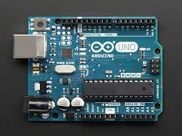
Arduino UNO x 2

Slide 5
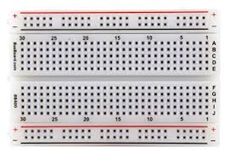
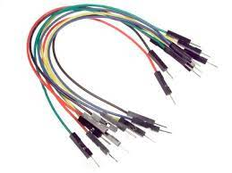
Breadboard jumper cables

Slide 6
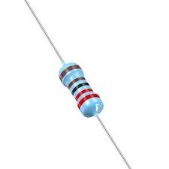
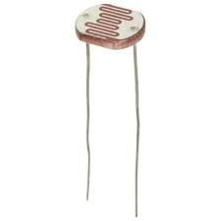
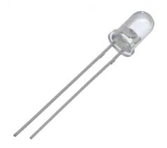
Resistor photoresistor led

Slide 7
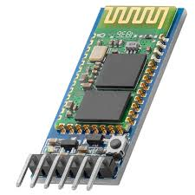
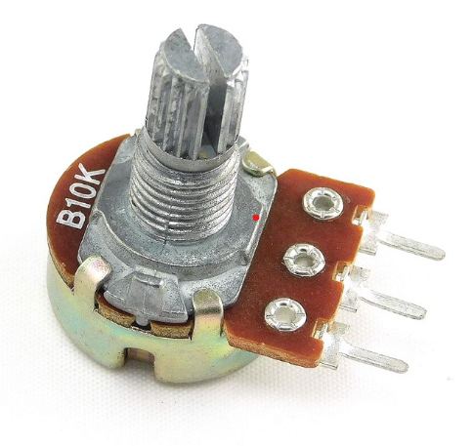
Bluetooth module potentiometer

Slide 8
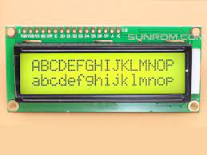
16x2 LCD

Slide 9
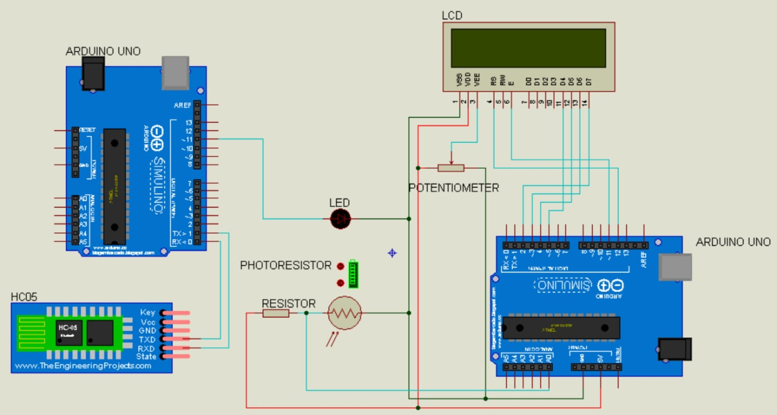
CIRCUIT DIAGRAM

Slide 10
PROJECT OVERVIEW
WE HAVE DIVIDED THE PROJECT INTO 2 PARTS
SENDER
RECEIVER

Slide 11
SENDER
In this, we will input the data from the system, and the data is processed on the Arduino. Each character is converted into its ASCII value.
Then, the ASCII value in decimal form is converted into its binary form.
After that, the data is transferred using led, in which a low state means 0 and a high state means 1.
WE SEND THE DATA IN INTERVALS OF 100 MILLISECONDS SO THAT RECEIVER CAN READ THE DATA CORRECTLY

Slide 12
RECEIVER
The resistance of the photoresistor changes when light falling on the photoresistor changes.
After finding the resistance, we set a threshold value of the resistance so that we can differentiate between the values 0 and 1.
It will keep taking the values until all the data is transferred.
After the transfer of every 8 bits, the ASCII value of the character will be calculated in decimal form, converted into nature, and added to the string.

Slide 13
upgradation
FOR THE UP-GRADATION OF OUR PROJECT WE ARE USING VOICE AS A METHOD OF INPUT AND A 16X2 LCD FOR THE OUTPUT OF THE TRANSMITTED DATA.

Slide 14
THANK YOU

